Slide 1
CHANGE MANAGEMENT-II
ITIL CHANGE MANAGEMENT BEST PRACTICES
http://www.bmc.com/guides/itil-change-management.html

Slide 2
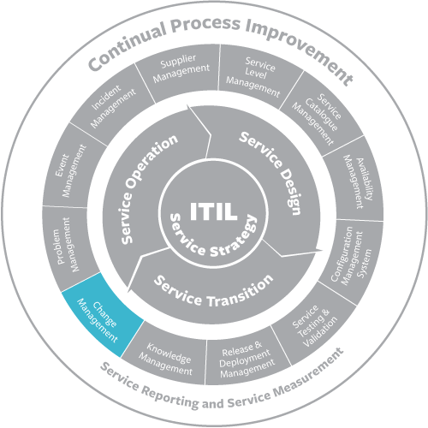
CHANGE MANAGEMENT-II

Slide 3
CHANGE MANAGEMENT-II
Mission
The mission of the IT change management process is to implement changes in the most efficient manner, while minimizing the negative impact on customers when changes are implemented. KPIs for tracking success of the IT change management process are:

Slide 4
CHANGE MANAGEMENT-II
i. Successful changes: The number of changes that have been completed successfully compared to the total number of completed changes. The higher the percentage of successful changes, the better.

Slide 5
CHANGE MANAGEMENT-II
ii. Backlog of changes: The number of changes that are not yet completed. While this absolute number depends on the size of the organization, it should not grow over time.

Slide 6
CHANGE MANAGEMENT-II
iii. Emergency changes: The number of completed “emergency” changes. This absolute number depends on the size of the organization and should not increase over time.

Slide 7
CHANGE MANAGEMENT-II
Scope
The scope of the IT change management process is limited to change implementations that will cause:
A service to become unavailable or degraded during service hours

Slide 8
CHANGE MANAGEMENT-II
Scope
ii. The functionality of a service to become different
iii. The CMDB to require an update
Other IT changes don’t usually require formal change management. Instead, they can be tracked as standard IT activities.

Slide 9
CHANGE MANAGEMENT-II
IT Change Management Procedures
a. Request for change review: Change coordinators use this procedure when they are dealing with requests for change.

Slide 10
CHANGE MANAGEMENT-II
b. Change planning: Change coordinators and specialists employ this process to prepare the implementation plans for changes.
c. Change approval: The change manager and approvers (e.g., customer representatives and service owners) follow this procedure to approve planned changes.

Slide 11
CHANGE MANAGEMENT-II
d. Change implementation: Specialists use this process to implement infrastructure changes.
e. change closure: Specialists follow this procedure when they perform production tests after changes have been implemented, and change coordinators employ it to close out changes.
END

